Slide 1
Movies & revenue
A CASE STUDY & REGRESSION OF MOVIE PROFITABILITY

Slide 2
By performing a regression, I found that movie companies should focus on their hiring decisions in order to maximize revenue. My regression also concluded in an equation to predict revenue based on a variety of factors with an r² value of ~0.25. I identified trends in genre, runtime, release dates, and revenue through our case study.
!
PART 1: CASE STUDY
- Which genre maximizes revenue?
- Does release date affect revenue?
- What types of movies perform better?
- Is there a relationship between runtime and revenue?
!
PART 2: REGRESSION
-Do certain factors have a stronger correlation with revenue?
- Can we create an overall predictive equation for revenue? If so, how accurate is it?
- How strong is the correlation between revenue and all variables?

Slide 3
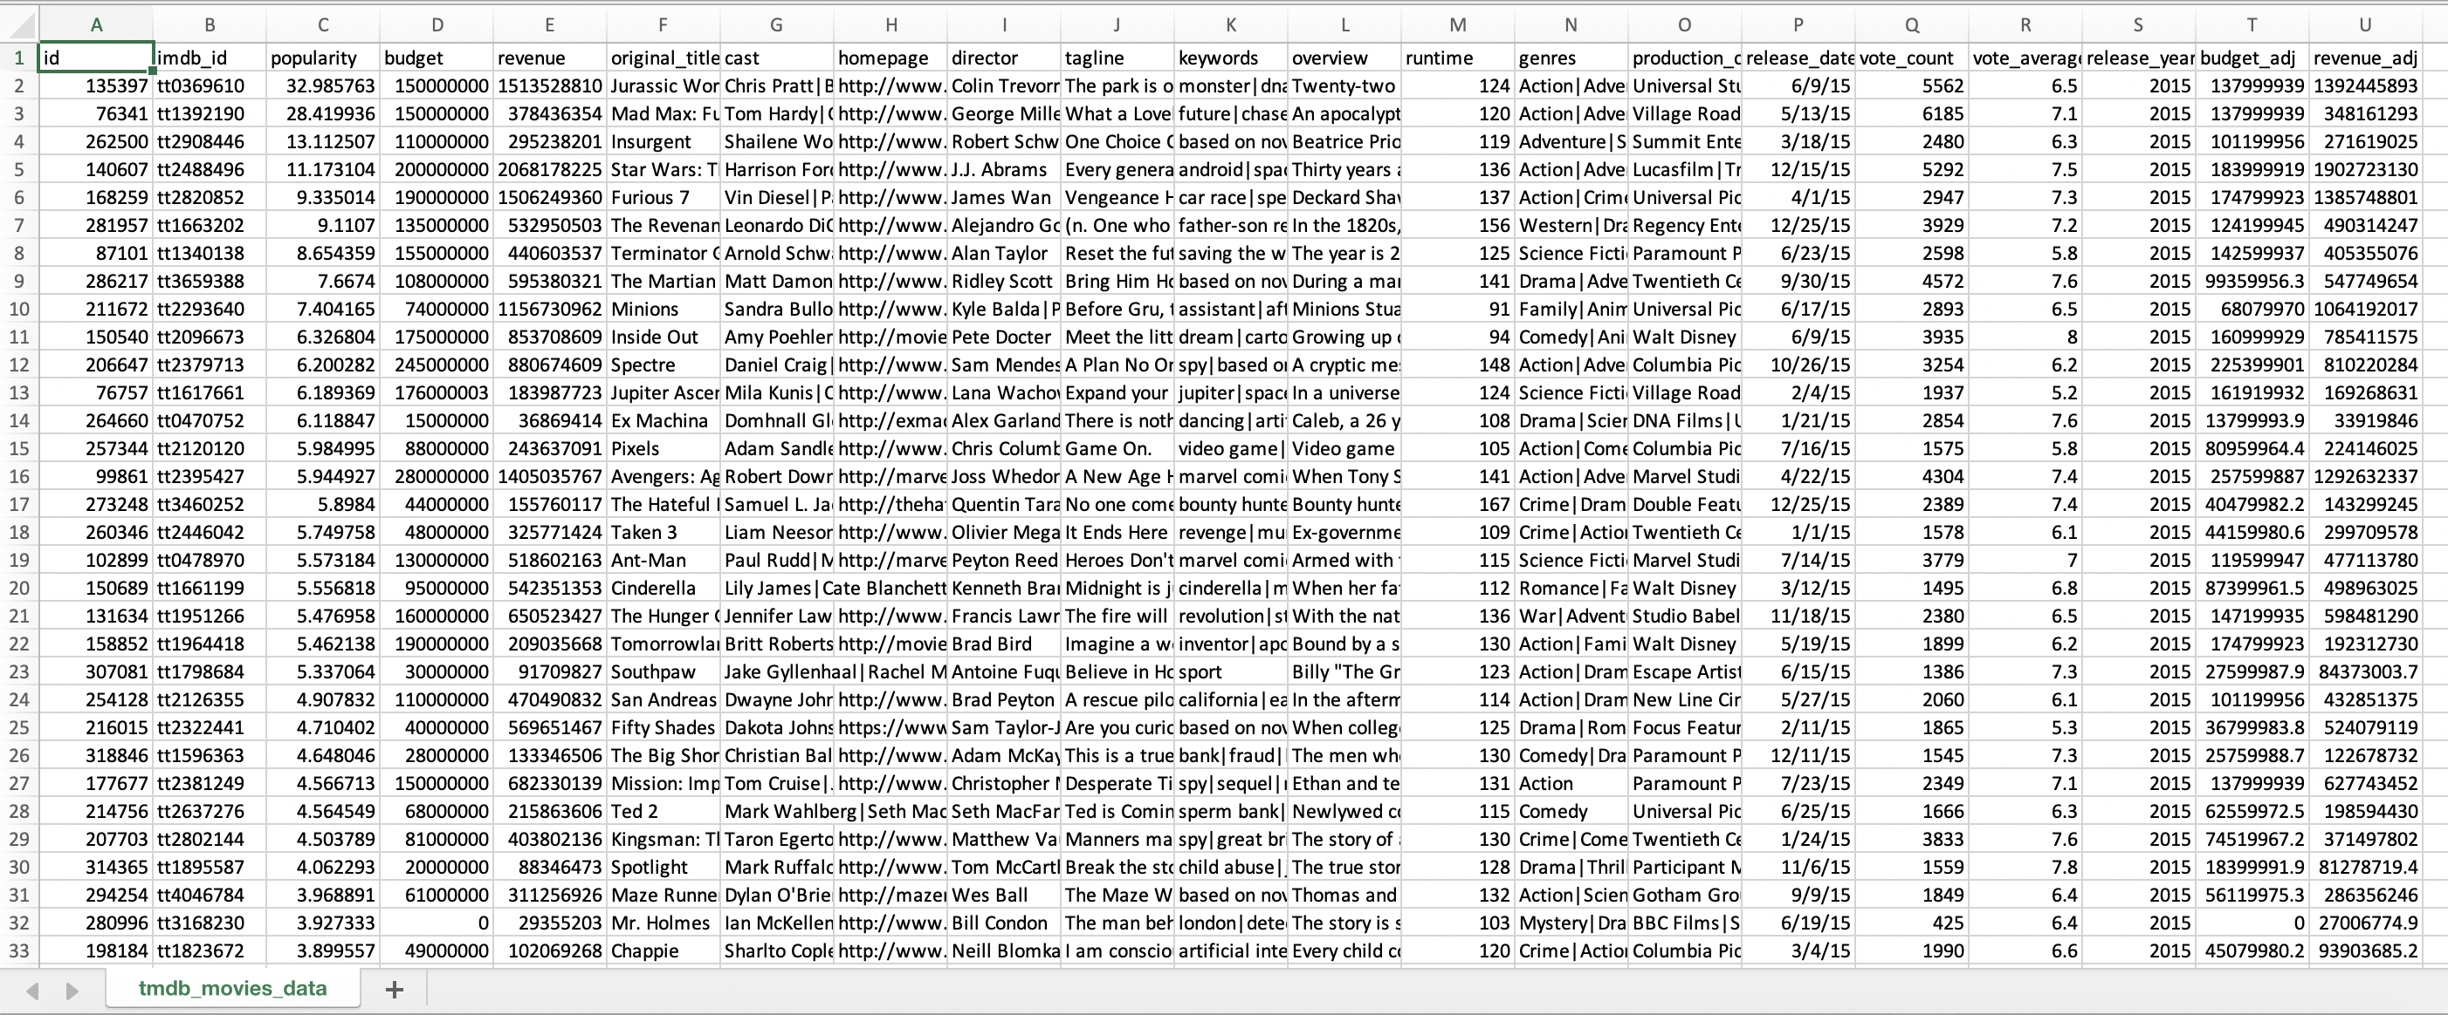
THE DATASET
-- WORKSHEET --

Slide 4
Variables
I selected 5 variables and observed their relationships with the adjusted revenue.
Genre
Cast & Director
Category based on similarities in the narrative element or emotional responses
The stars who act in the movies, and the ones who supervise
Runtime
Release Date
Length of the movie (minutes)
The time period when the movie is released
Production Company
Adjusted Revenue
Act as the intersection between the movie itself and the film industry
Revenue adjusted for inflation using the base year of 2010

Slide 5
Part 1: the case study
-- VISUALIZATIONS CREATED IN TABLEAU --

Slide 6
PART 2: THE REGRESSION
-- CREATED IN EXCEL --

Slide 7
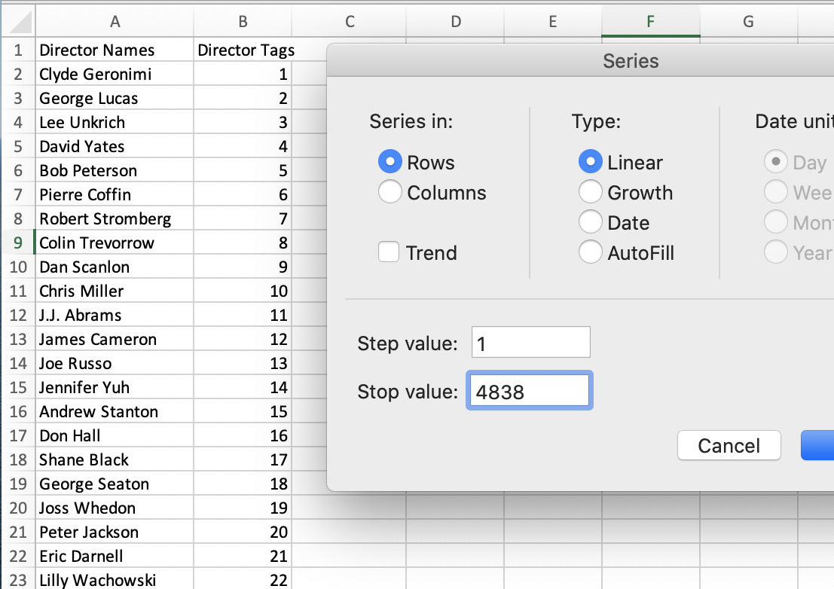
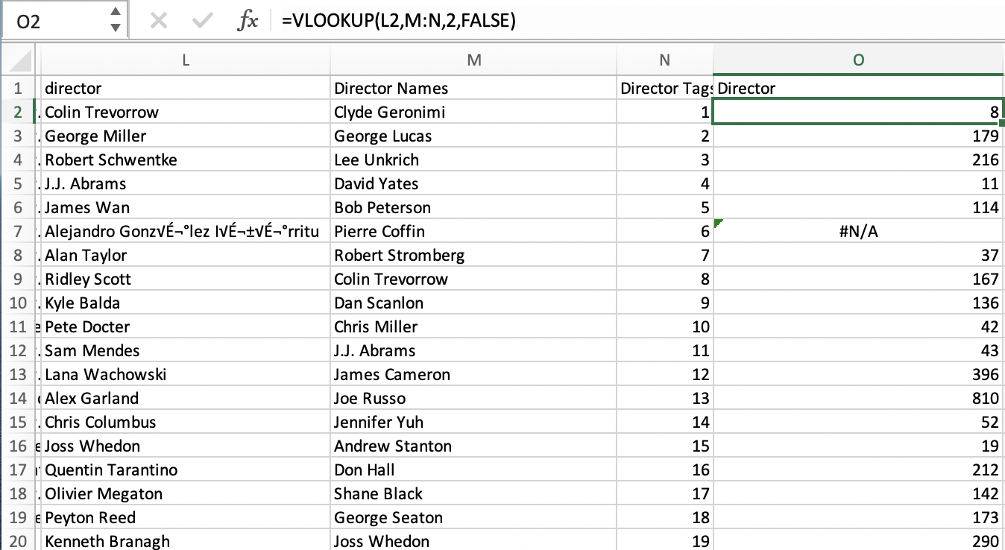
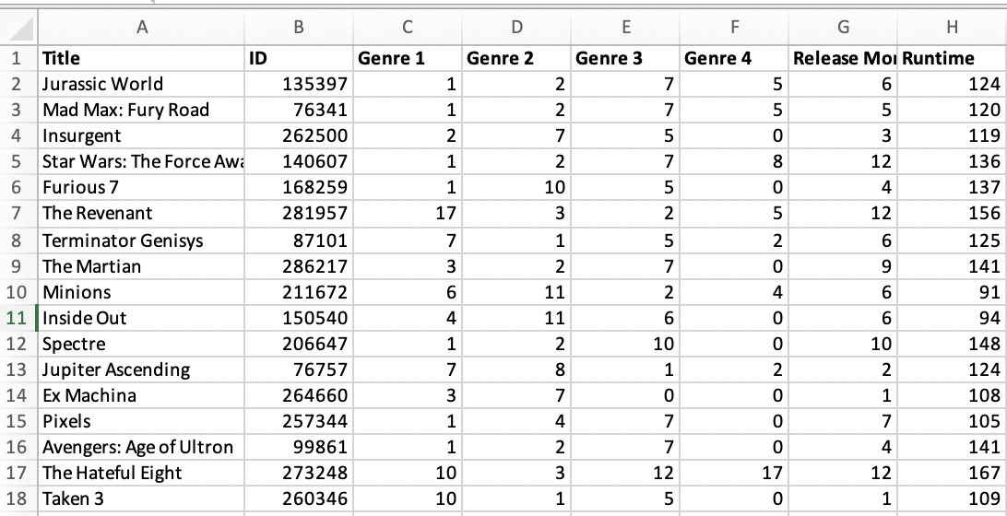
Data preparation
By tagging the data and using various Excel functions, I cleaned the dataset and prepared it for regression.
2. Match with original data using =VLOOKUP
3. Create a worksheet with all tagged data
1. Tag qualitative data

Slide 8
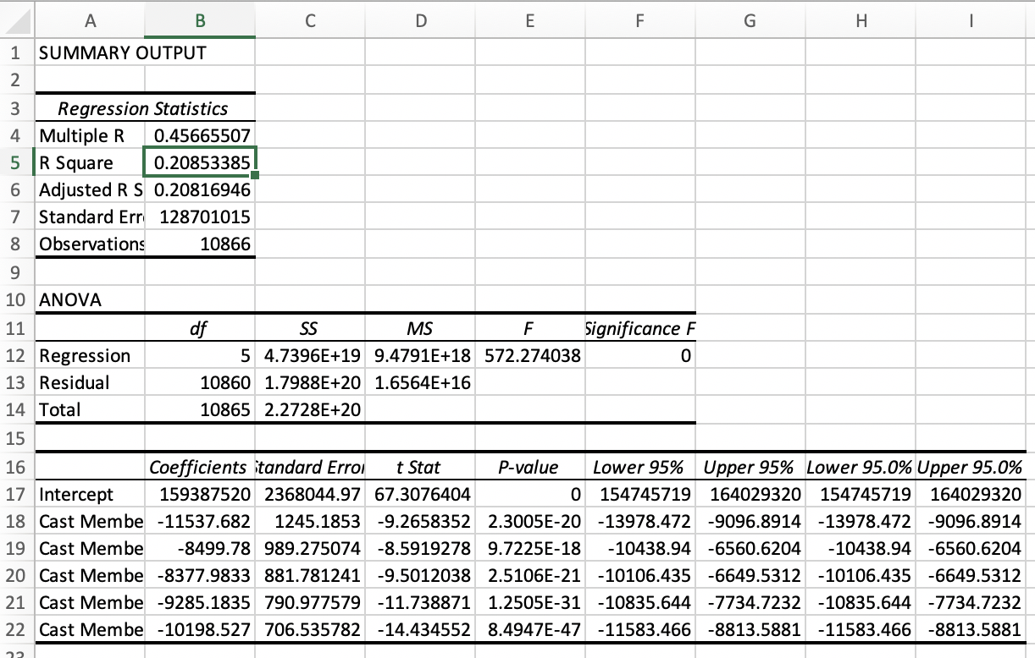
Individual regression
Through the regressions I performed, I found that the cast and director for a movie had the strongest correlations with revenue.
Cast: R²= 0.208533852719812, p-value
Director: R²= 0.121383564498438
Production Co: R²= 0.0767575668226115
Runtime: R²= 0.0308621275345542
Genre: R²= 0.013040942566452
Release Date: R²= 0.00256862976872277

Slide 9

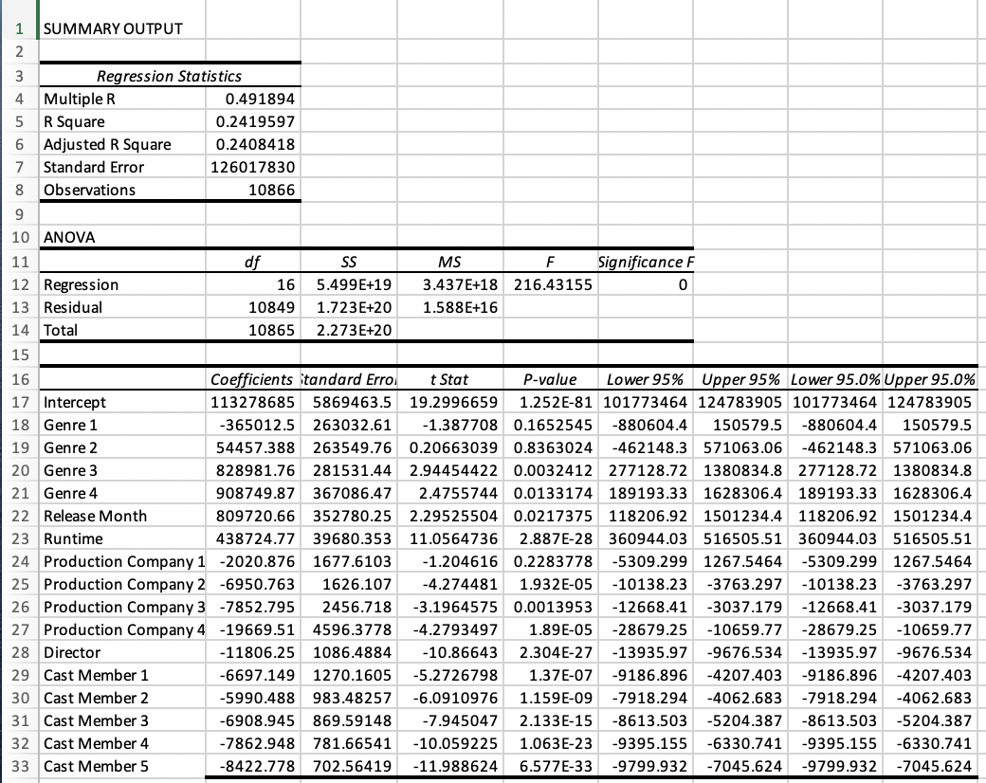
Overall Regression
The overall regression equation was reasonably accurate, with an r² value of 0.25, in capturing the relationship between the variables we chose and the revenue.
Revenue = 113278685
- 365012.46(Genre 1)
+ 54457.39(Genre 2)
+ 828981.76(Genre 3)
+ 908749.87(Genre 4)
+ 809720.66(Release Month)
+ 438724.771(Runtime)
2020.8763(Production Company 1)
6950.76(Production Company 2)
7852.79(Production Company 3)
19669.51(Production Company 4)
11806.25(Director)
6697.15(Cast Member 1)
5590.49(Cast Member 2)
6908.95(Cast Member 3)
7862.95(Cast Member 4)
- 8422.78(Cast Member 5)

